Slide 1
Air Q assessment TN
Done by

Slide 2
Content
Public view for problem. The importance of the project. The goal of the research. Methods used to predict. Result. Conclusion.

Slide 3
Public view for problem
Most major cities suffer from high concentrations of air pollutants at the ground level, so regulating air pollution levels has become one of the most important tasks for governments in developing countries, especially China.

Slide 4
Indicator of air pollutants
Is the sum of all solid and liquid particles suspended in the air, many of which are dangerous. This complex mixture contains both organic and inorganic particles such as dust and smoke, which is a major concern for people’s health when it rises in air PM 2.5 refers to small particles in the air that reduce vision and cause haze when the levels rise

Slide 5
Important Of the Project
Great impact on human health and ecosystems. Air pollution degrades air quality and leads to many diseases, most notably asthma

Slide 6
Goal of research
This research aims to predict the level of air pollution with a set of data used to make predictions through them and to obtain the best prediction using several models and compare them and find the appropriate solution.

Slide 7
Method using to predict
Multiple linear regression
Feedforward Neural Network Based on Back Propagation Extreme Learning Machine

Slide 8
MLR
✔Multiple Linear Regression (MLR) models are trained on the basis of current measurements.It used to predict the future concentrations of air pollutants in accordance with meteorological variables. Disadvantge: Clear values and noise in data strongly affect the performance of these regression-based algorithms.

Slide 9
FFANN-BPS
✓ Possesses the advantages of integrating complex nonlinear relationships betweenthe concentration of air pollutants and corresponding meteorological variables. ✓ They are widely used to predict the concentration of air pollutants.
Disadvantge: 1. Its ability to generalize is weak and falls within the local micro-value. 2. Lack of choice of analytical model. 3. Consumes a lot of time

Slide 10
ELM
Best Method
It has a stronger circulation than conventional statistical methods and ANN with maximum learning speed.

Slide 11
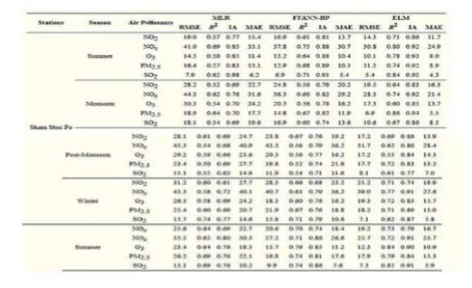
Result

Slide 12
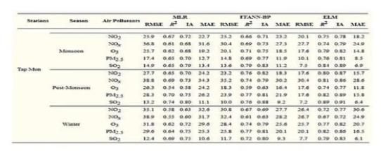
The best Method is which has a height value of R2 and a low value of
RMSE

Slide 13
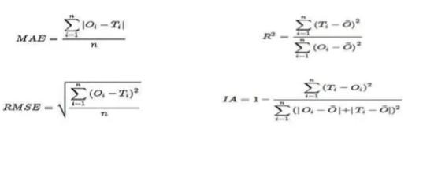
Law using

Slide 14
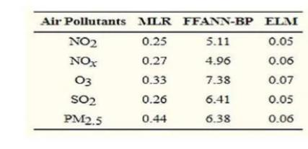
Training Periods
> ELM has the best performance

Slide 15
Conclusion
In this paper, we proposed to predict the concentration of air pollutants on the basis of ELM, where the best performance was performed on safety prediction indicators such as R2, RMSE, etc. The present study revealed that ELM performs slightly better than simple statistical techniques.

Slide 16

THANKYOU

